Slide 1


Predicting Hotel Booking Cancellations
Author: Razvan Nelepcu
Mentor: Dhiraj Khanna

Slide 2
Project organization
The project follows all steps of Data Science workflow divided in the following major steps:
Problem Identification
Data wrangling
Exploratory Data Analysis
Pre-processing and training data development
Modeling
Documentation

Slide 3
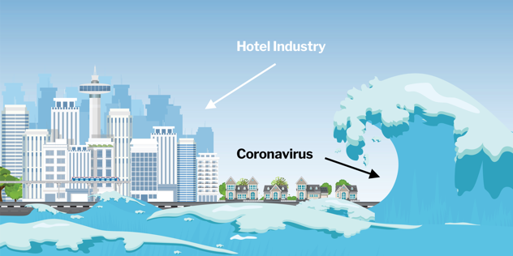
Context and Problem statement
PROBLEM IDENTIFICATION
DATA WRANGLING
EDA
PRE-PROCESSING
MODELING
DOCUMENTATION
We are at a point where nobody can say that their lives were not affected by the Coronavirus pandemic. Even if it was having someone close getting sick or even die, losing the job or having to change the working style completely to working from home, or just the fact that you had to see the
friends and relatives over video.
The businesses were also heavily impacted by the pandemic.
Bars and restaurants, airlines and hotels were the businesses
that took the hardest hit.
With pre-pandemic cancelation rate around 40% and considering
current situation, it became crucial for hotels to identify the
customers who might cancel their reservation and establish a
Business strategy to have them keep their reservation. For their survival in a pandemic and post-pandemic world, hotels must adapt and use all tools available to maximize profits.
For these reasons we considered working on a Project that uses hotels booking data with the goal to apply the Data Science Methods in order to predict future bookings cancelations, respectively the cancelations likelihood for new bookings.

Slide 4
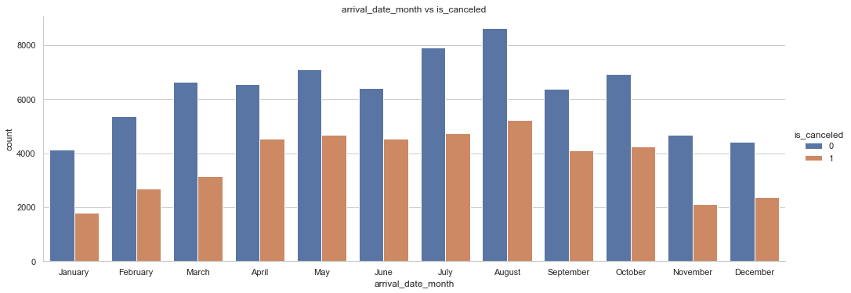
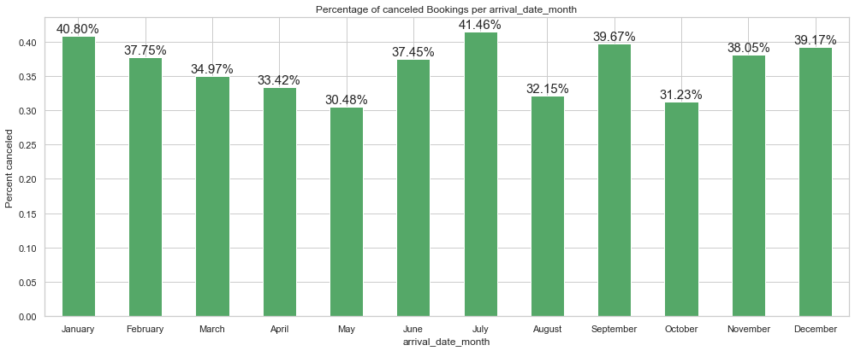
PROBLEM IDENTIFICATION
DATA WRANGLING
EDA
PRE-PROCESSING
MODELING
DOCUMENTATION
Data Wrangling
The data was downloaded from ScienceDirect.
It contains more than 100,000 booking records from 2 hotels in Portugal, a hotel in Lisbon and a resort hotel in Algarve. The period covered was between 1st of July of 2015 and the 31st of August 2017.
The dataset had a total of 32 features containing information such as:
arrival date, number of adults, children or babies, if they are previous
guests, how many prior cancellations they had and other.
Before proceeding with data cleaning and dealing with missing values
and outliers, we considered necessary to have a deeper look into the
data. This was done separately for numerical and for categorical
features.
Some key findings after doing the initial feature exploration were:
The average cancelation rate was 37.04%
99% of people with non-refundable deposits canceled their booking
From all outliers only 1 was considered a wrong entry and removed

Slide 5
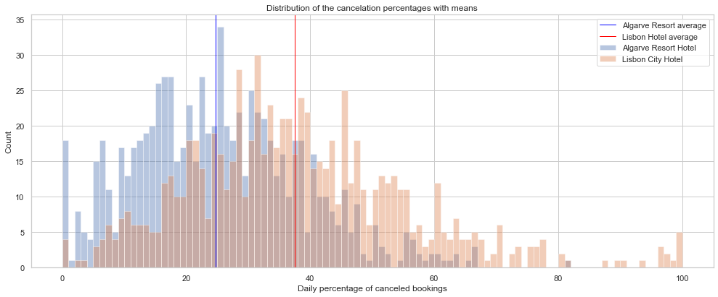
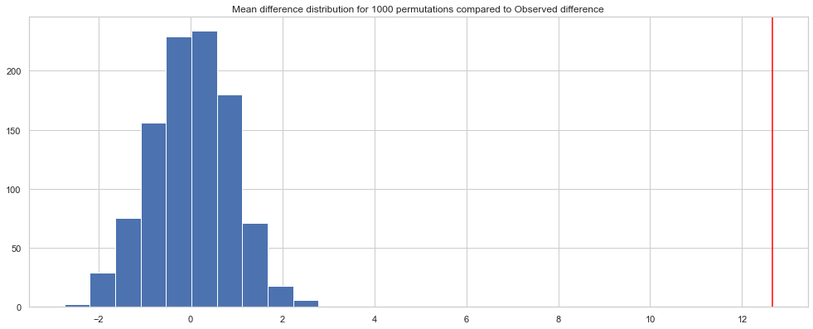
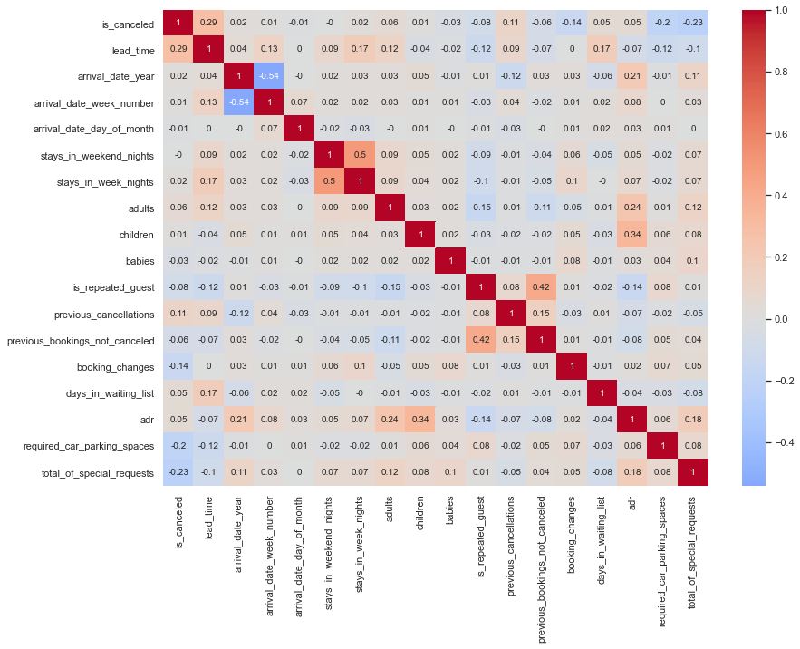
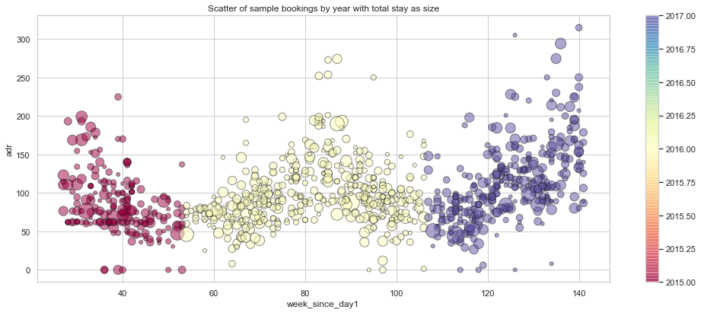
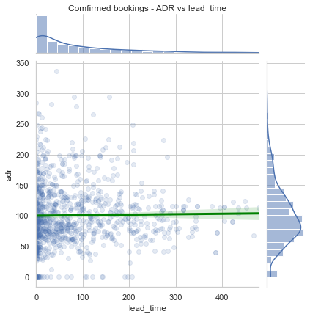
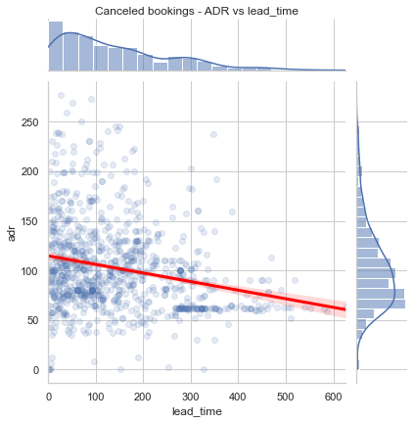
PROBLEM IDENTIFICATION
DATA WRANGLING
EDA
PRE-PROCESSING
MODELING
DOCUMENTATION
Hypothesis testing
We conducted a statistical hypothesis testing to check if the 2 hotels’ cancellations were significantly different.
We visualized the Heatmap to visualize all correlations from our numerical features
Using the correlations discovered we continued with bivariate EDA and multivariate EDA.
Lastly, we explored our data to find an answer to the question: Why 99% of customers with non-refundable deposits are cancelling?

Slide 6
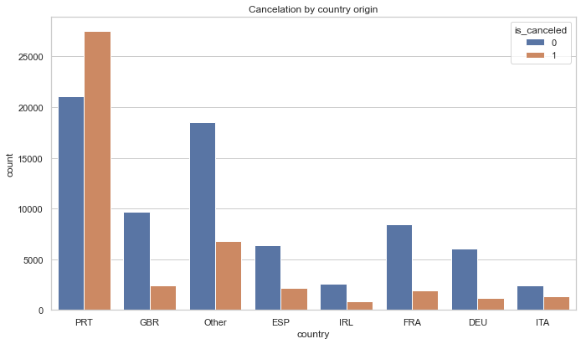
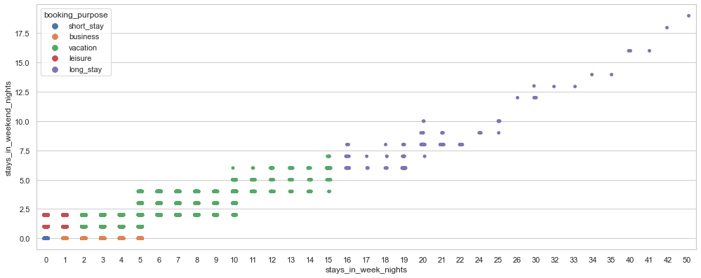
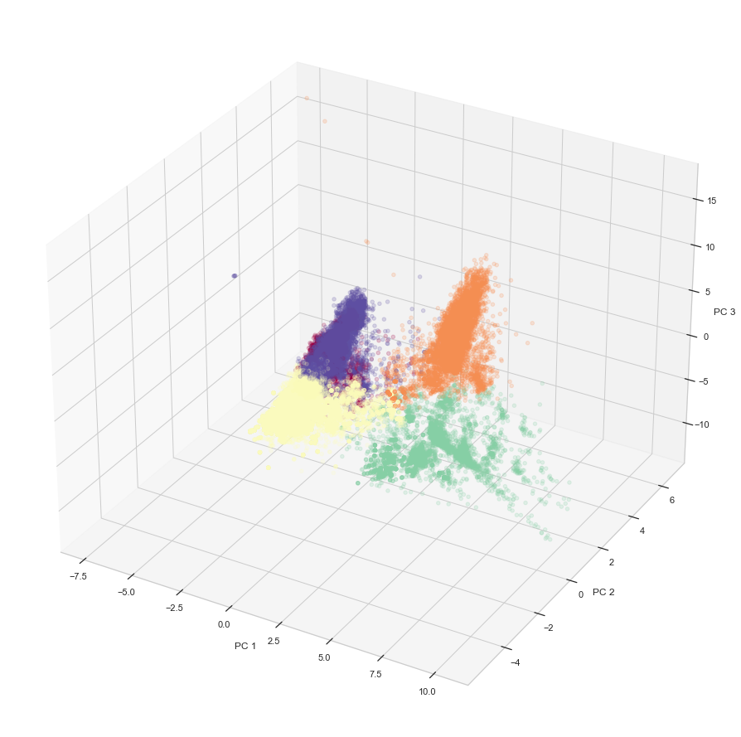
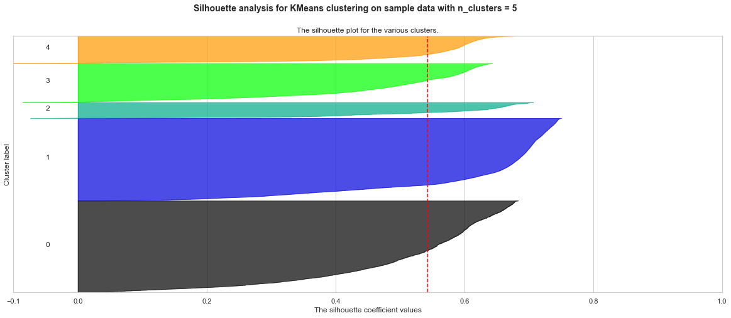
PROBLEM IDENTIFICATION
DATA WRANGLING
EDA
PRE-PROCESSING
MODELING
DOCUMENTATION
Pre-processing
The pre-processing had 3 major parts:
Data Leakage analysis. We checked with our dataset authors to
make sure there was no data leakage. Some features what might
have constituted data leakage were analyzed, and we considered
just the country origin to be source of data leakage and removed it.
Feature engineering. Using available data and domain knowledge
we created 3 more features:
arrival_day_of_week
booking_purpose
received_different_room
Customer segmentation using Unsupervised Learning
(Kmeans). We used elbow method and silhouette
scores and plots to find the optimal number of cluster: 5.

Slide 7
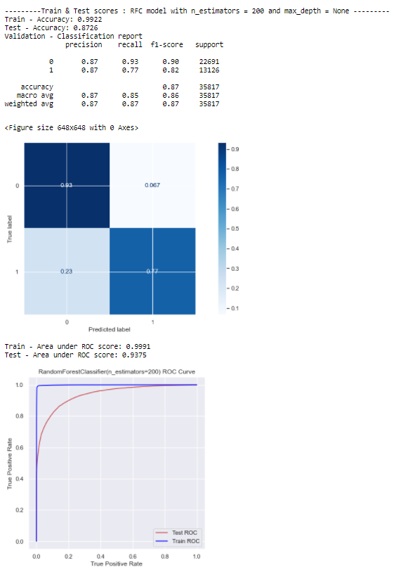
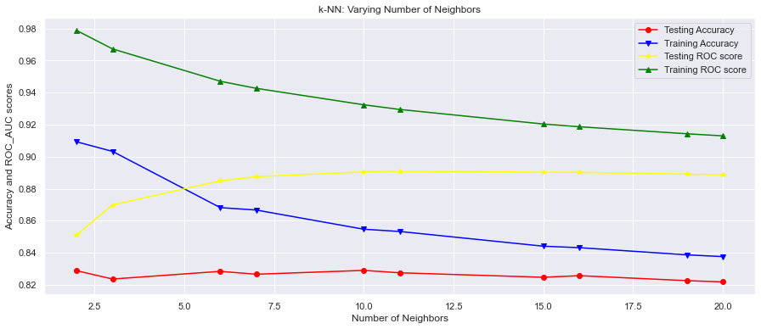
PROBLEM IDENTIFICATION
DATA WRANGLING
EDA
PRE-PROCESSING
MODELING
DOCUMENTATION
modeling
Metrics used: Accuracy and ROC’s area under the curve for ranking and additional confusion matrix and classification report from visualization. We used a DataFrame to save the metrics.
The models used were: LogisticRegression, KNN, Random Forest Tree and Catboost.
Other Tools used:
Hyperparameter Tuning Using GridsearchCV and RandomSearchCV
Regularization using Lasso or
Ridge
Feature Decomposition using PCA
Feature Selection using
permutation_importance and
feature_importances_
Best model – RFT with n_estimators = 200
Accuracy: 0.8726
roc_auc score: 0.9375

Slide 8
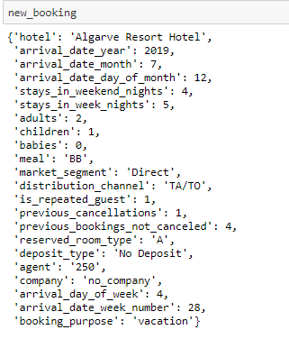
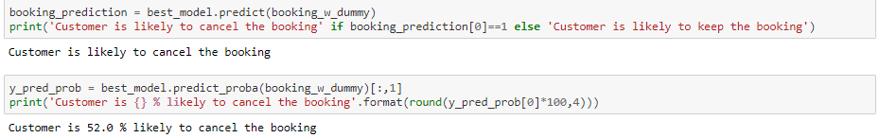
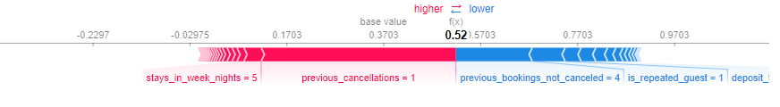
PROBLEM IDENTIFICATION
DATA WRANGLING
EDA
PRE-PROCESSING
MODELING
DOCUMENTATION
Recommendations
model implementation and usability
One aspect had under consideration was to have the prediction as fast as possible.
Identified 2 possible models that can be deployed:
Front Desk Cancellations Percentage model.
Monthly Cancellations Assessment.
Manually created a new random booking and calculated the prediction.
The predicted probability is 0.52, so a
52% cancellation percentage.

Slide 9
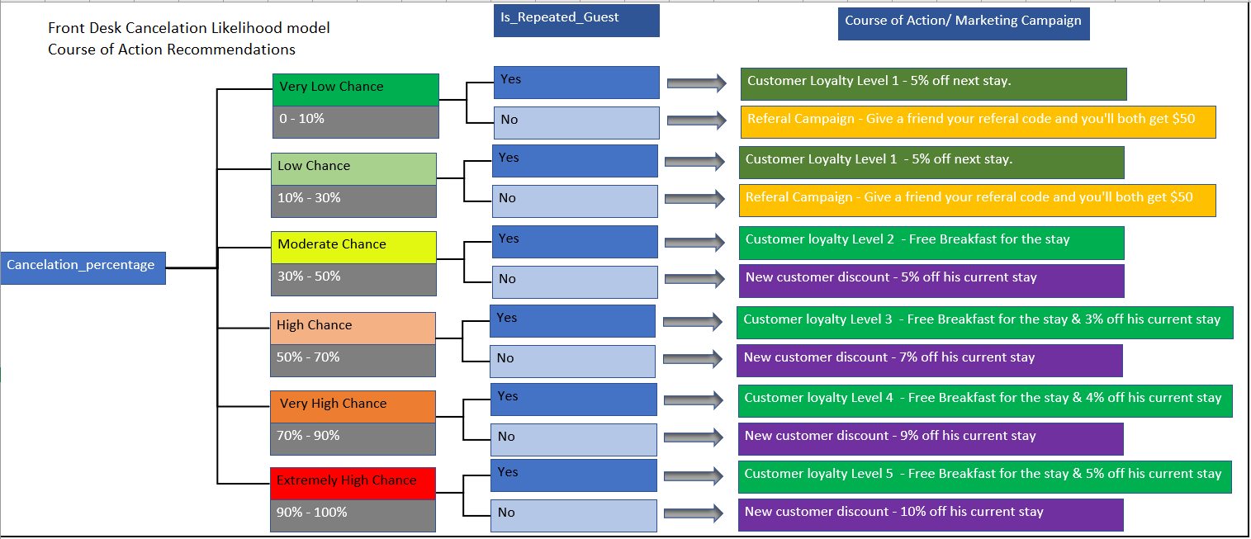
PROBLEM IDENTIFICATION
DATA WRANGLING
EDA
PRE-PROCESSING
MODELING
DOCUMENTATION
Recommendations
Business Course of Action using model

